Slide 1
UML Diagrams: Sequence Diagrams

Slide 2
Importance of Sequence Diagrams
Depict object interactions in a given scenario identified for a given Use Case
Specify the messages passed between objects using horizontal arrows including messages to/from external actors
Time increases from Top to bottom

Slide 3
Rules of Sequence Diagrams
Sequence Initiation

Slide 4
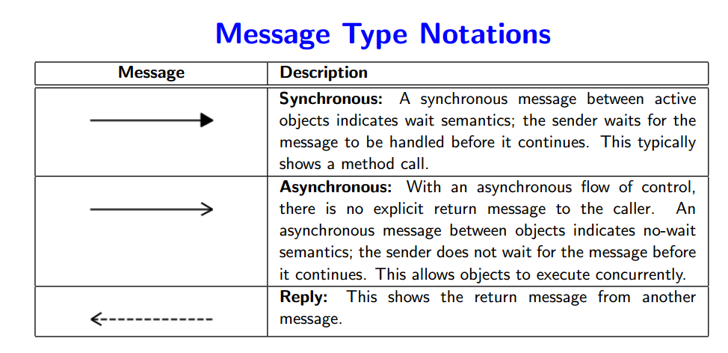

Slide 5
Rules of Sequence Diagrams
Messages specified on interactions can be synchronous or asynchronous
Synchronous call
Notes:
Also explain active and passive

Slide 6
Rules of Sequence Diagrams
Asynchronous call

Slide 7
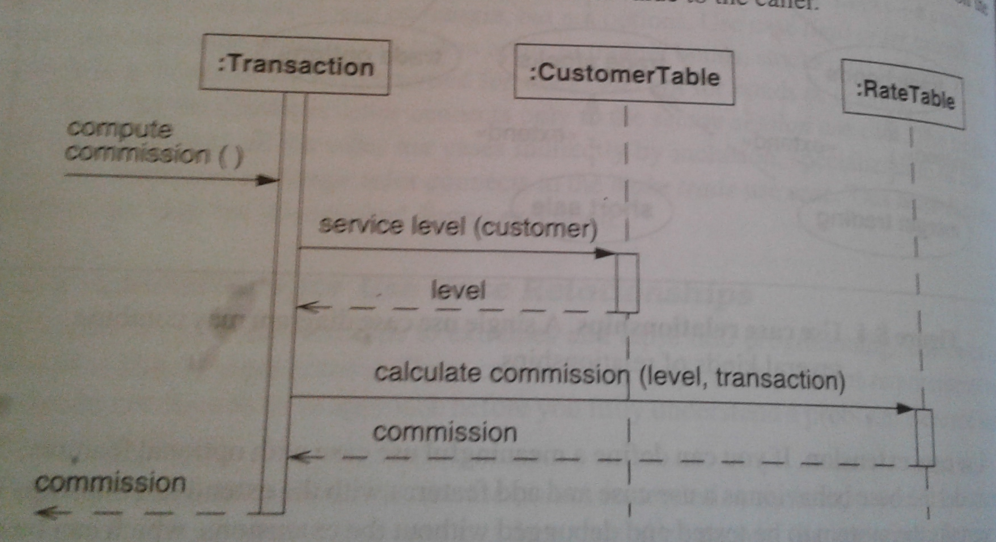
Difference between Active And Passive Objects

Slide 8
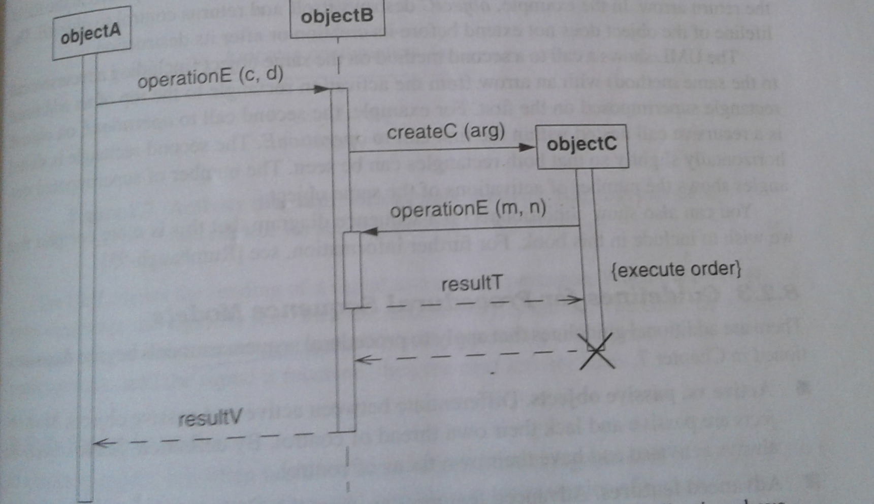
Transient Object

Slide 9
Rules of Sequence Diagrams
Display operation names on call arrows
Notes:
Transient objects

Slide 10
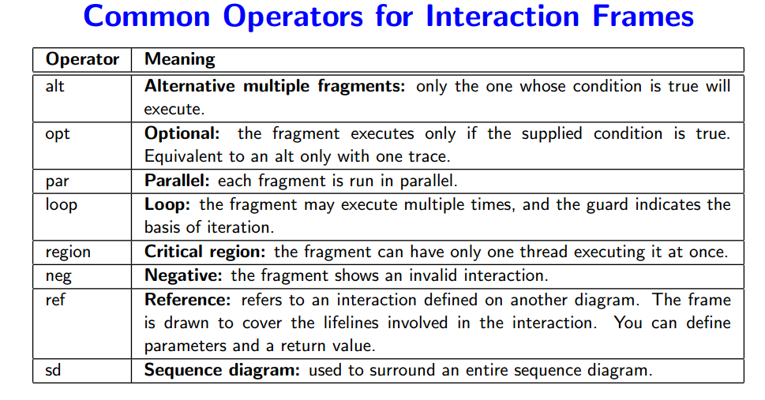

Slide 11
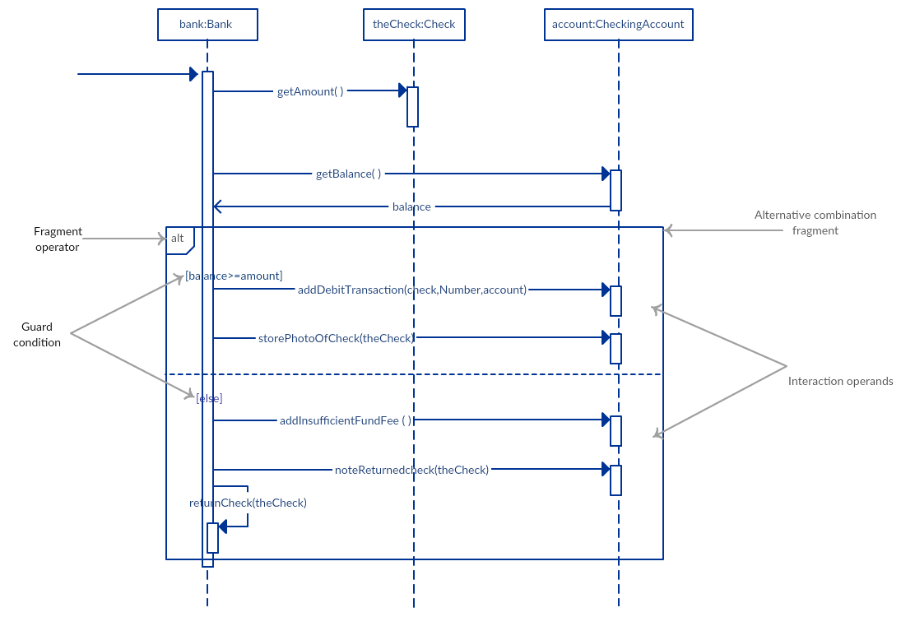

Slide 12
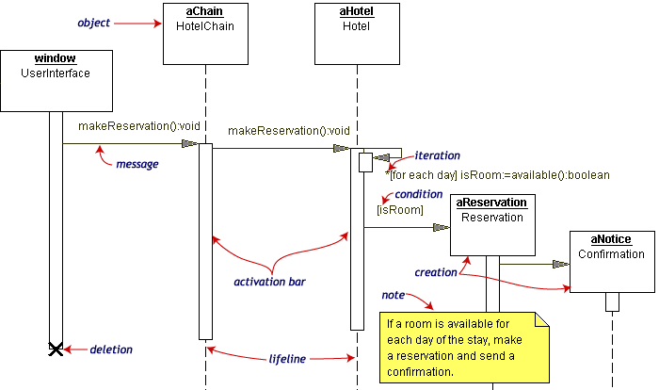
Other Examples of Sequence Diagrams

Slide 13
